Slide 1


Slide 2
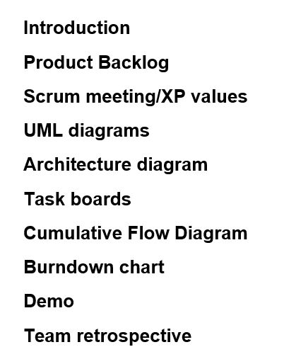
Agenda

Slide 3



Niral Koradia
Prathmesh Parmar
Aashish Subramanian
Neville Mascarenhas
Abhijitsinh Chavda

Slide 4
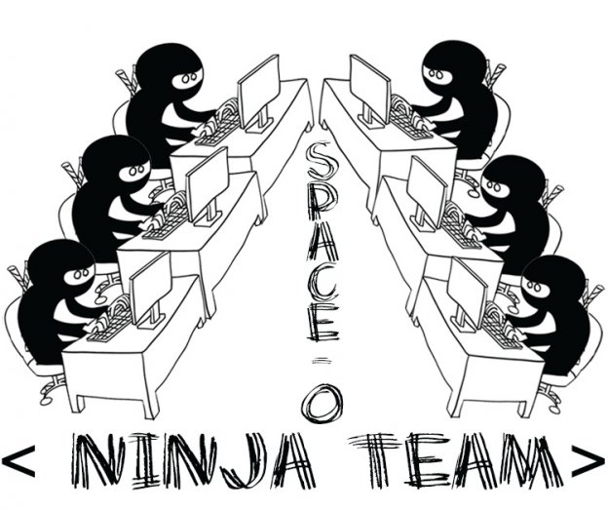
Scrum team
Scrum master:
Aashish Subramanian
Product Owner:
Neville Mascarenhas
Development team:
Niral Koradia
Prathmesh Parmar
Abhijitsinh Chavda

Slide 5

Product Backlog Refinement

Slide 6
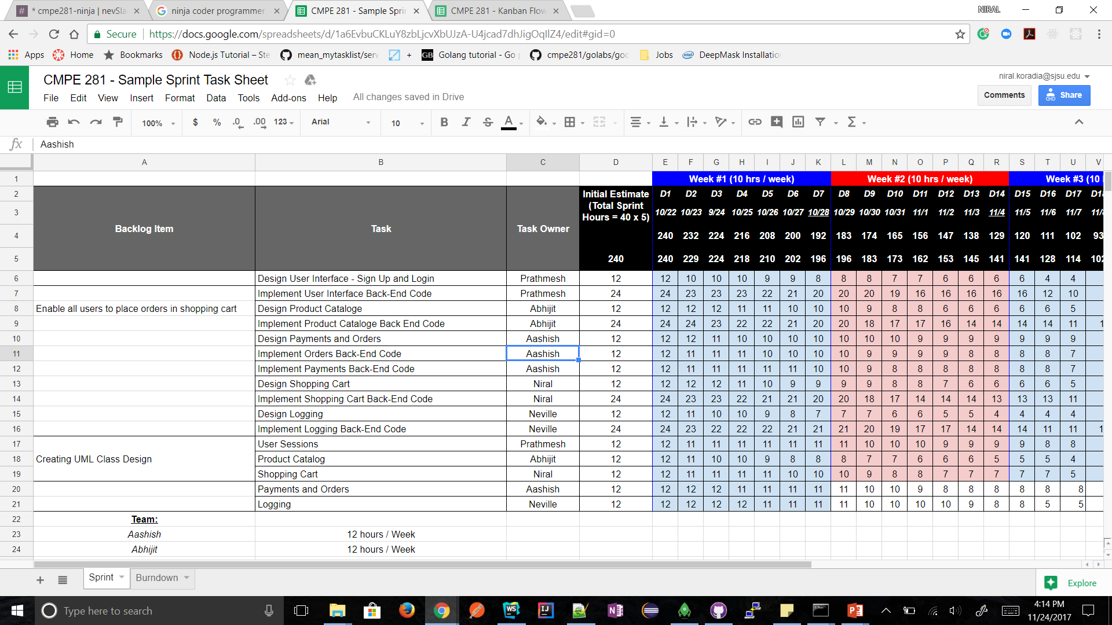
Backlog items

Slide 7
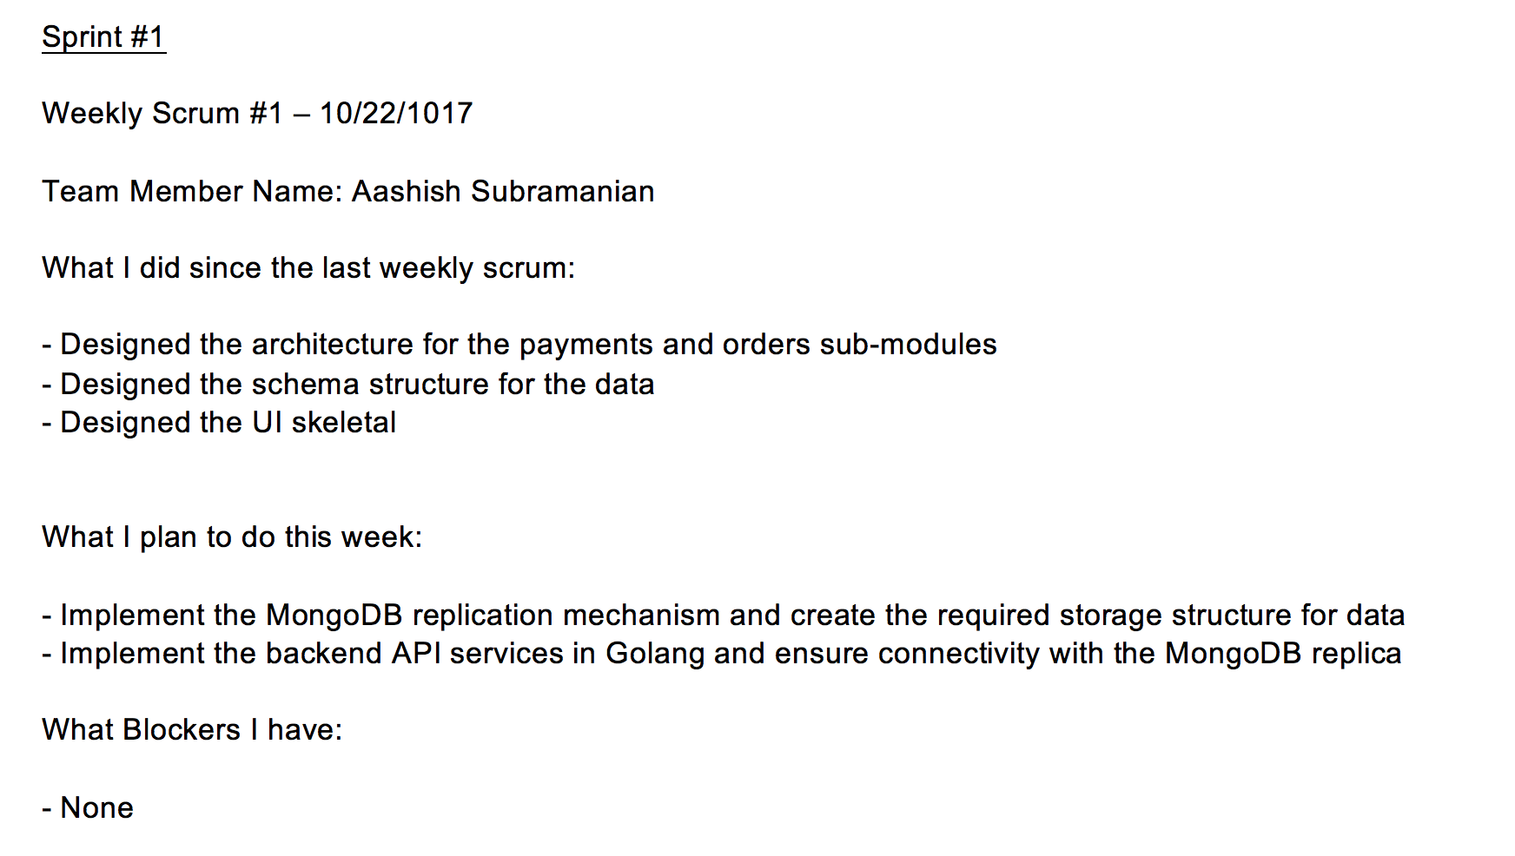
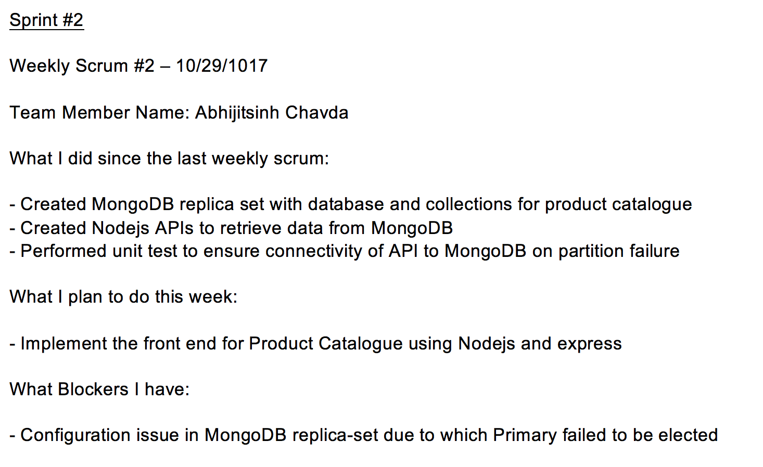
Team Scrum Meeting

Slide 8
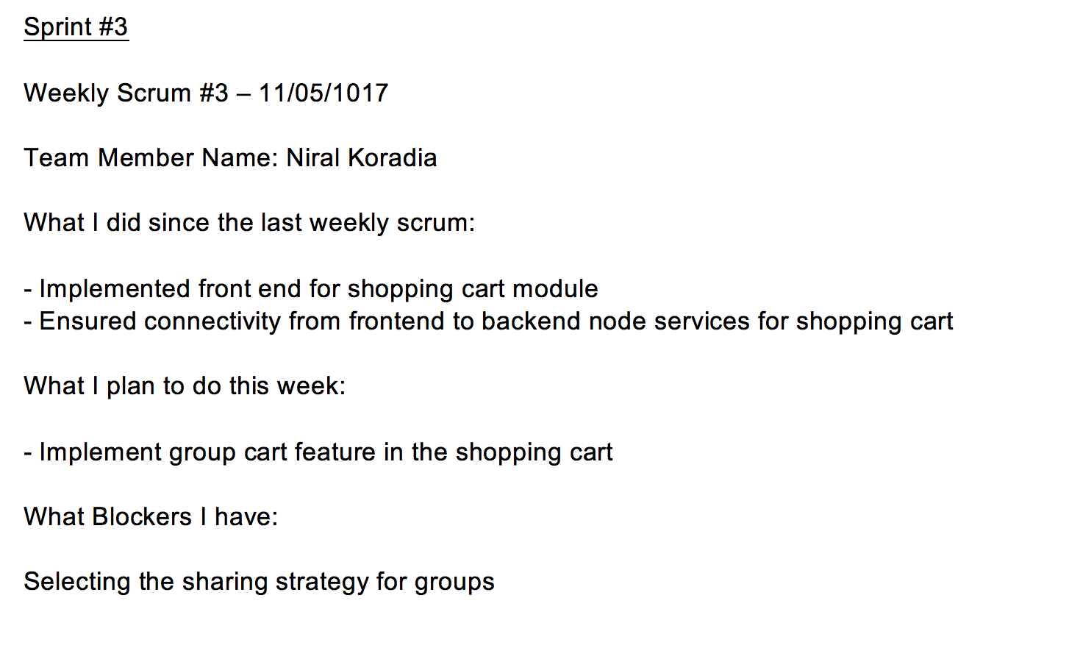
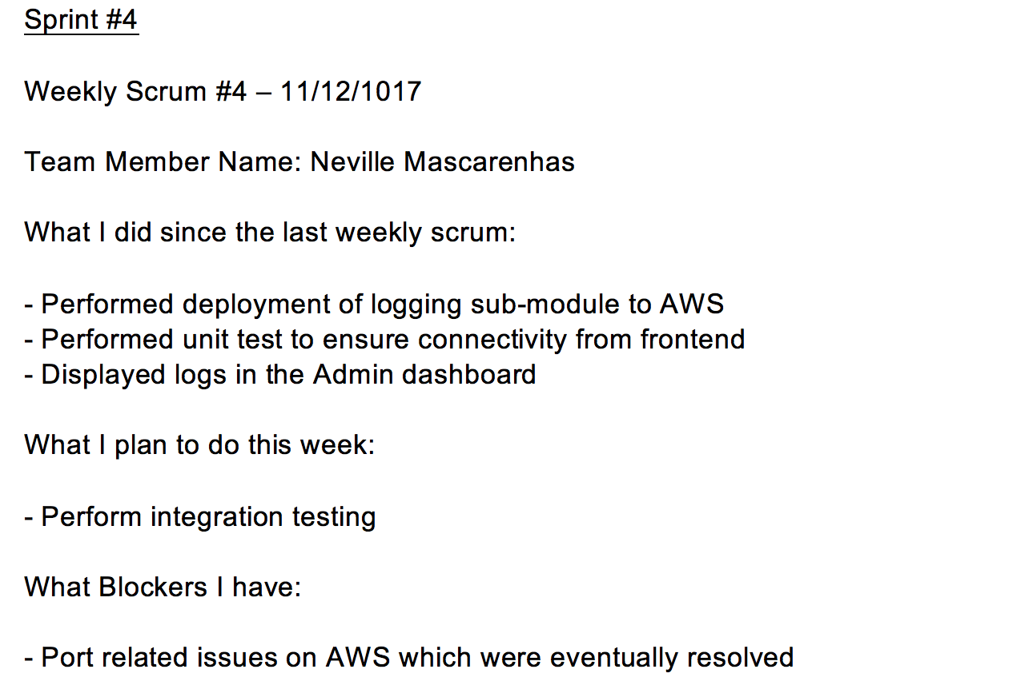
Team Scrum Meeting

Slide 9
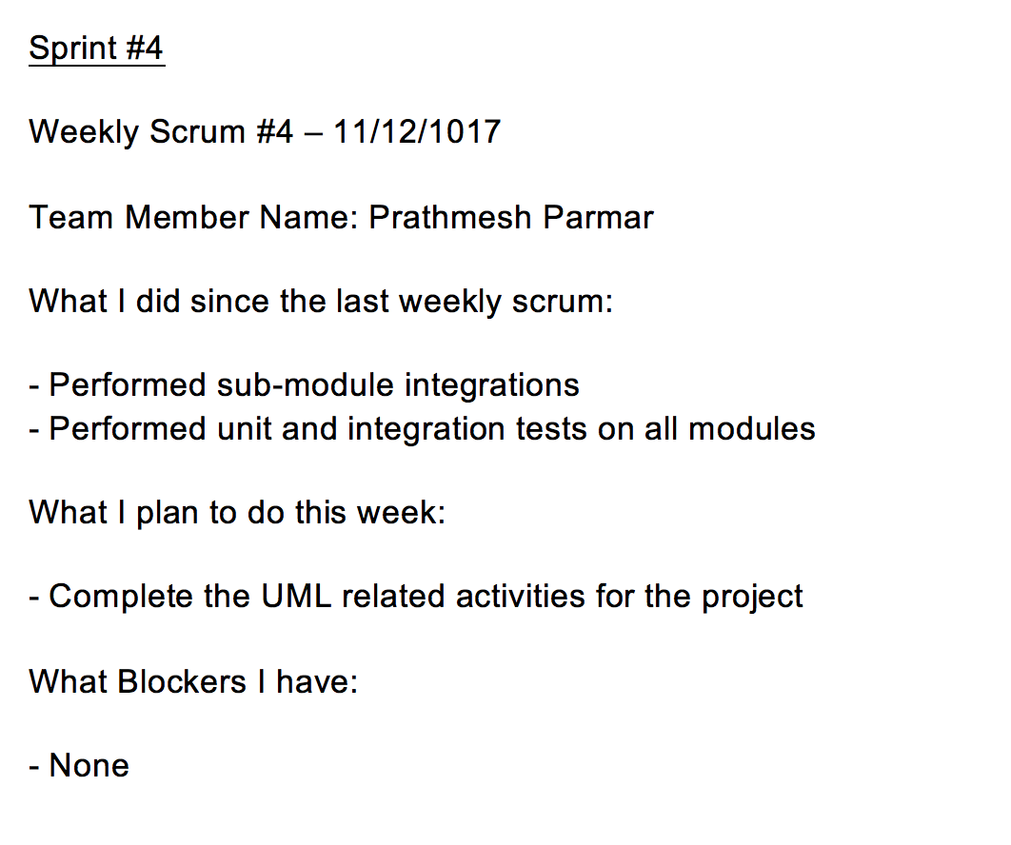
Team Scrum Meeting

Slide 10
Core Values
Simplicity
Communication
Eliminate Waste
Communication
Feedback

Slide 11
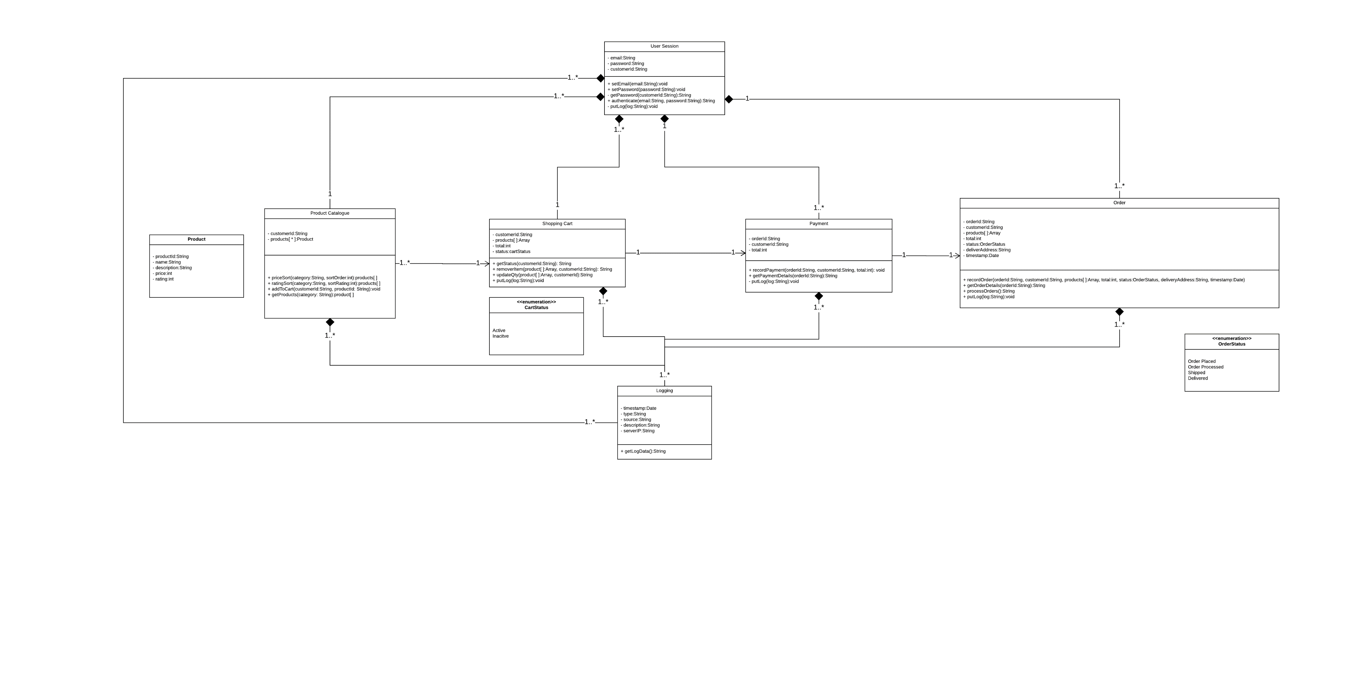
Class Diagram

Slide 12
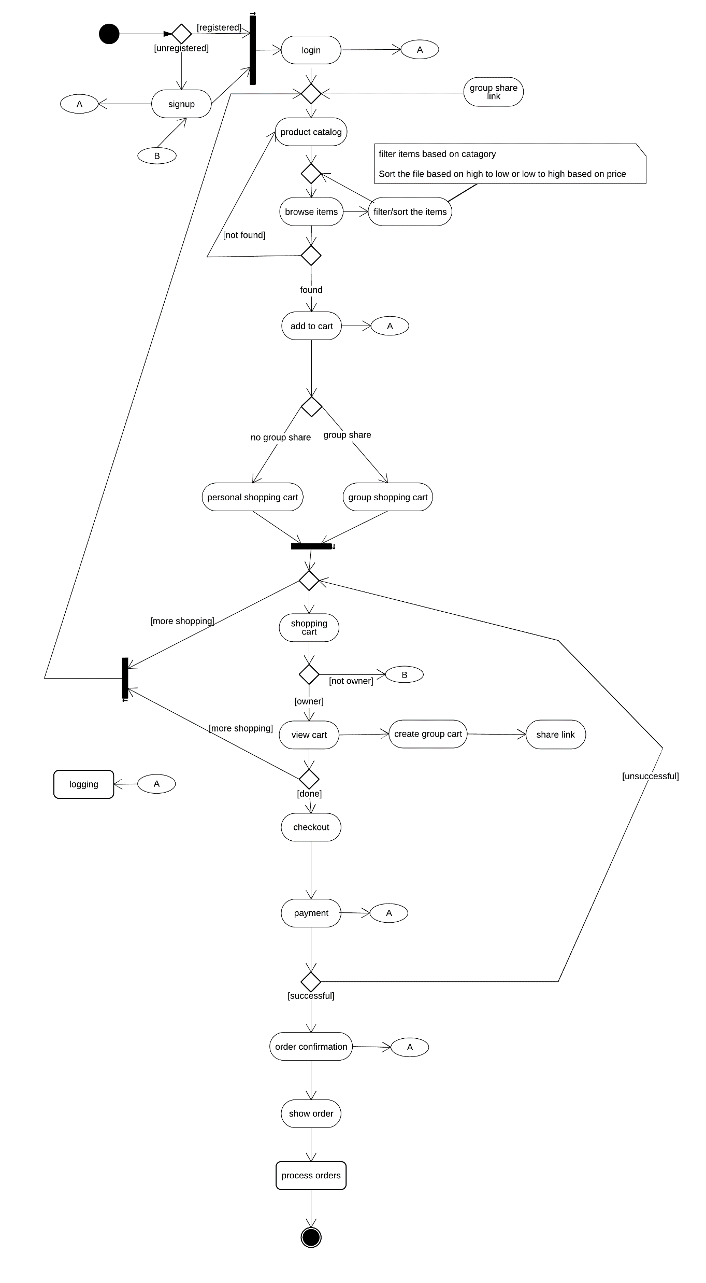
Activity Diagram

Slide 13
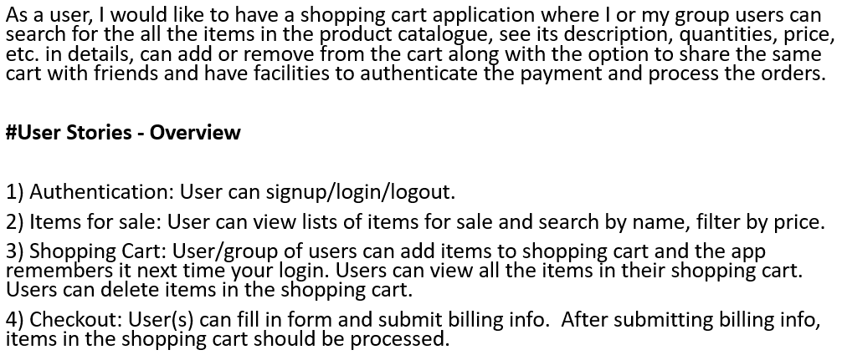
User Story

Slide 14
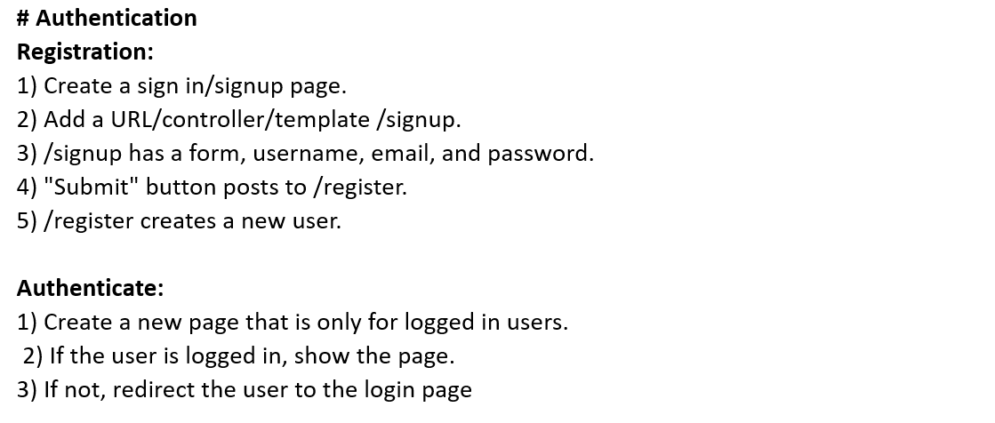
User Story

Slide 15
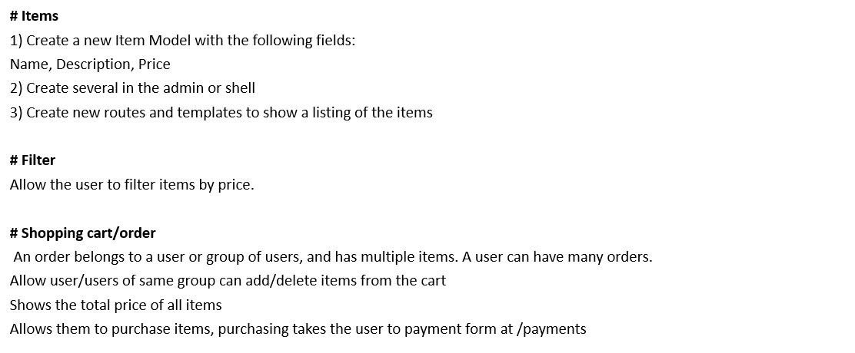
User Story

Slide 16
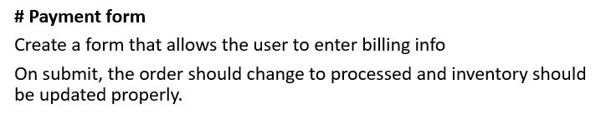
User Story

Slide 17
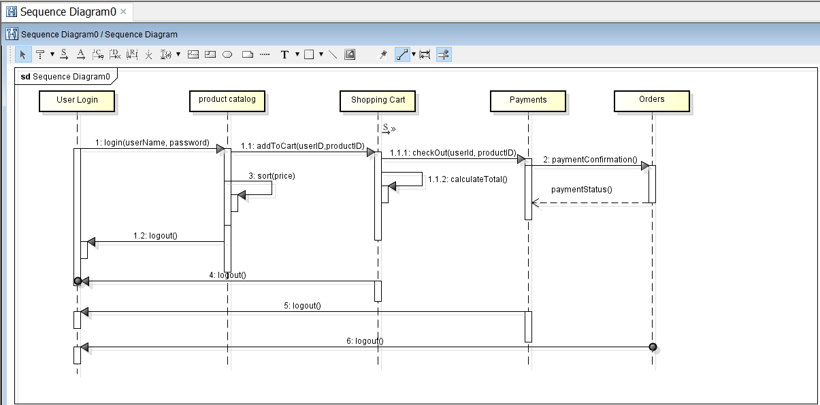
Sequence Diagram

Slide 18
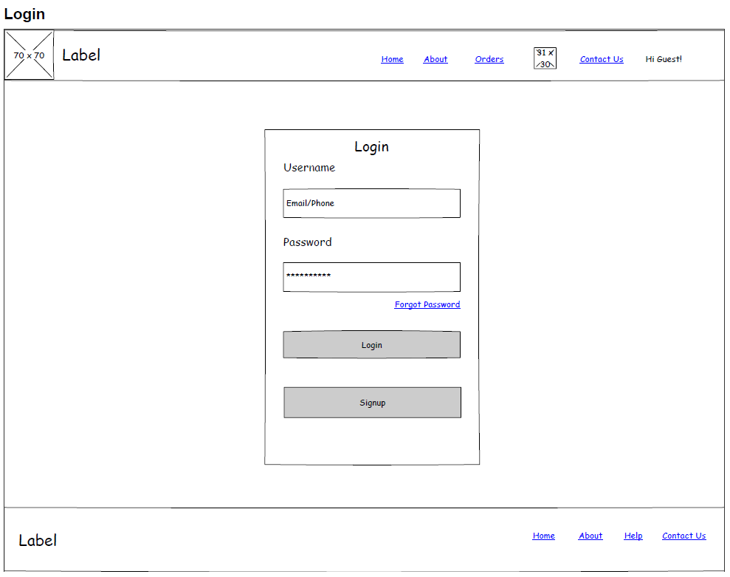
UI-WireFrames - Login

Slide 19
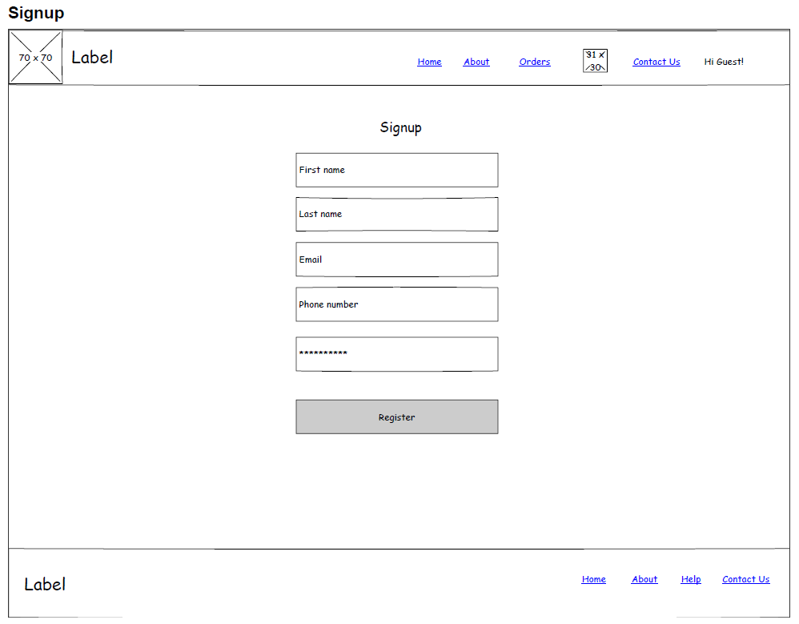
UI-WireFrames - SignUp

Slide 20
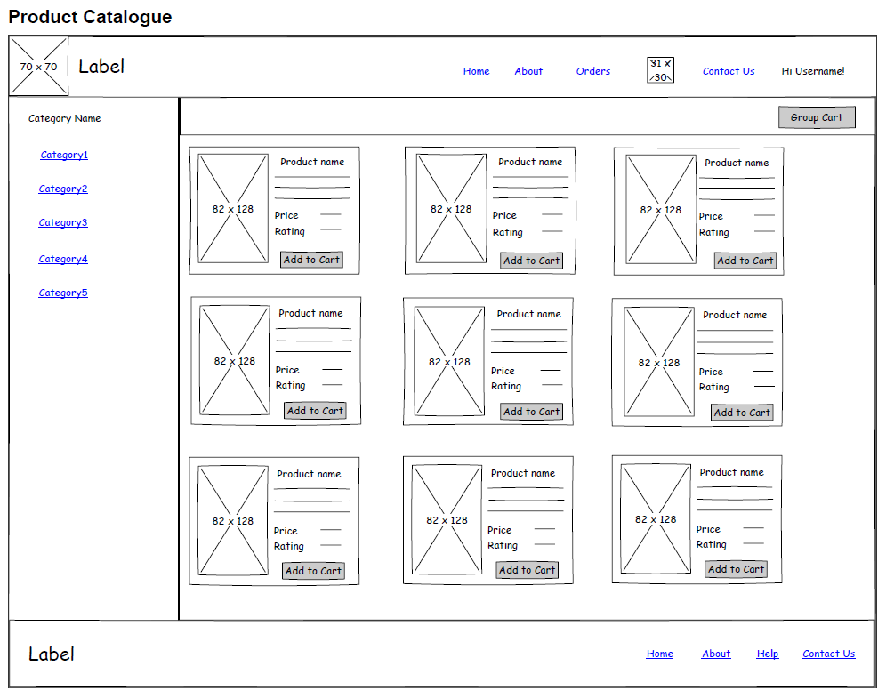
UI-WireFrames – Product Catalogue

Slide 21
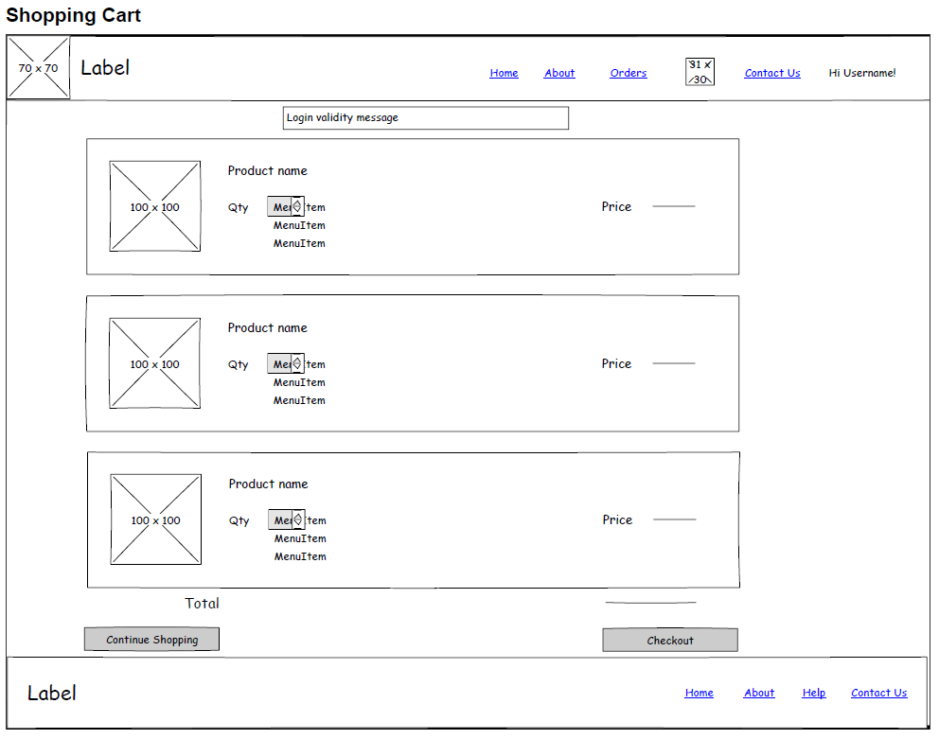
UI-WireFrames - ShoppingCart

Slide 22
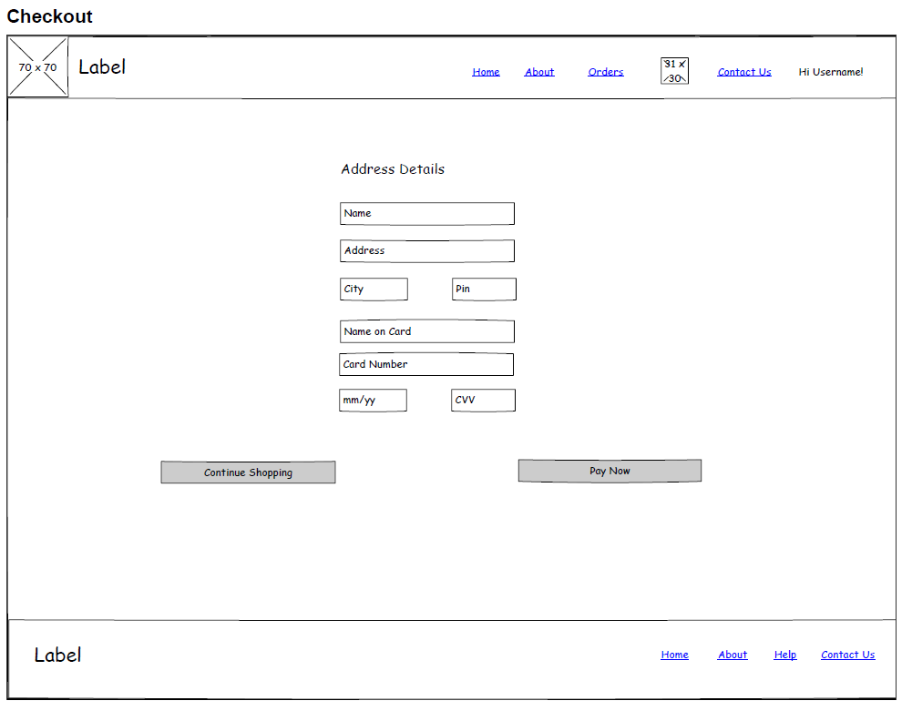
UI-WireFrames - CheckOut

Slide 23
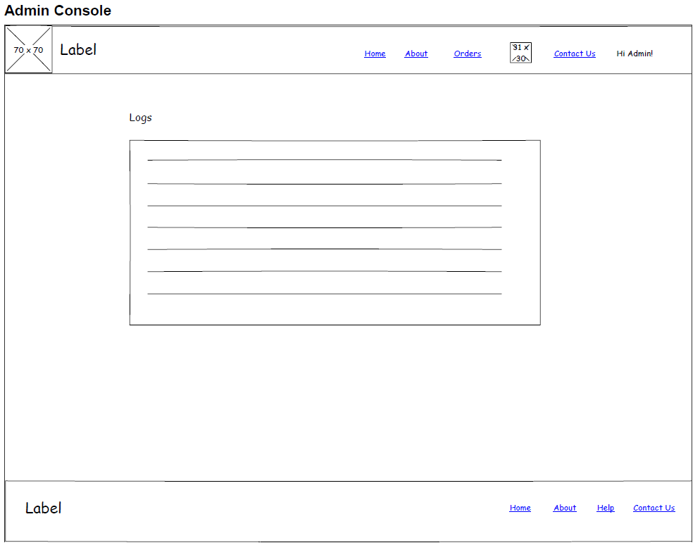
UI-WireFrames – Admin Console

Slide 24
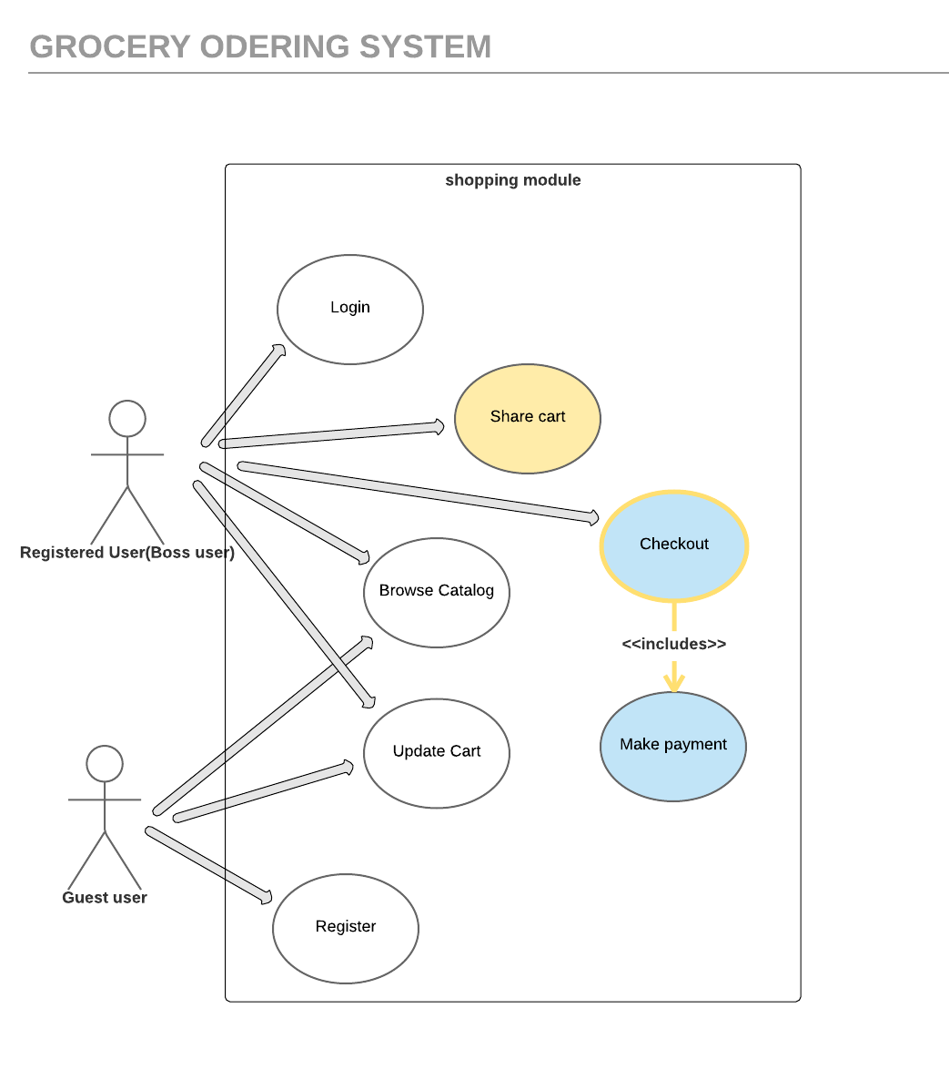
Use-Case Diagram

Slide 25
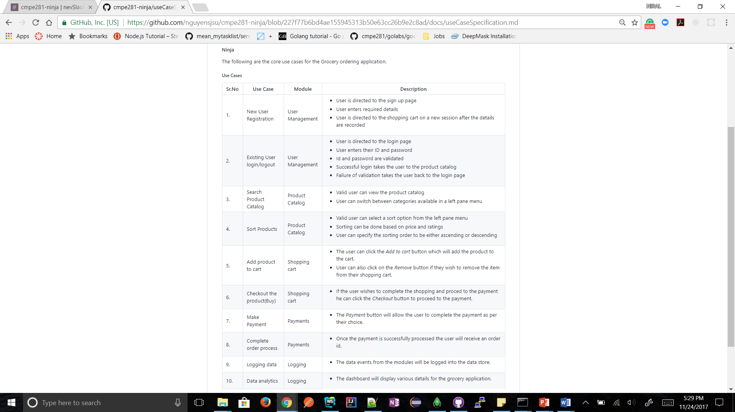
Use-Case Specification

Slide 26
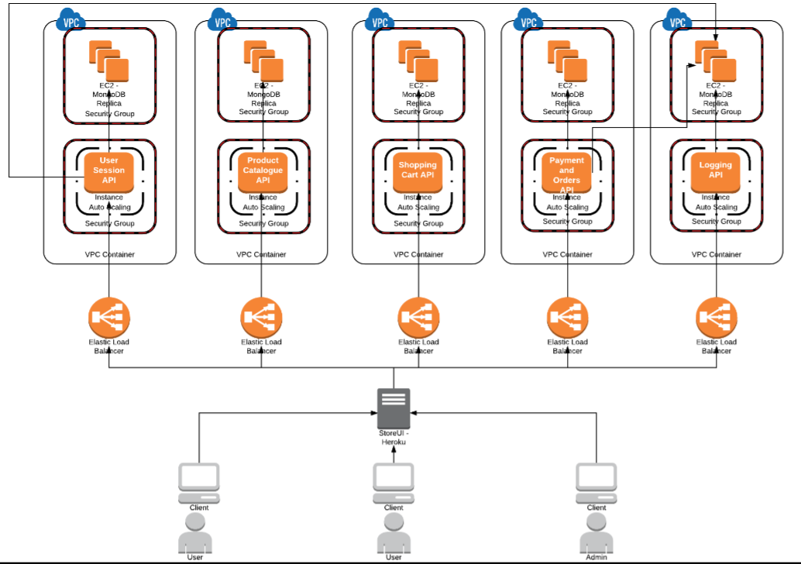
Architecture Diagram

Slide 27
Task Board
https://github.com/nguyensjsu/cmpe281-ninja/projects/1

Slide 28
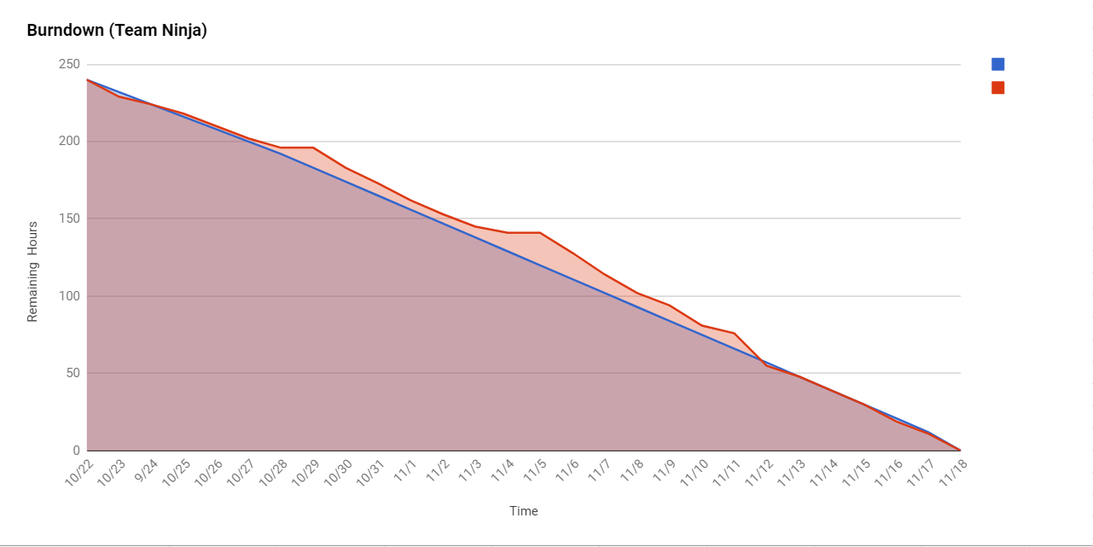
Burndown chart
https://docs.google.com/spreadsheets/d/1a6EvbuCKLuY8zbLjcvXbUJzA-U4jcad7dhJigOqIlZ4/edit#gid=0

Slide 29
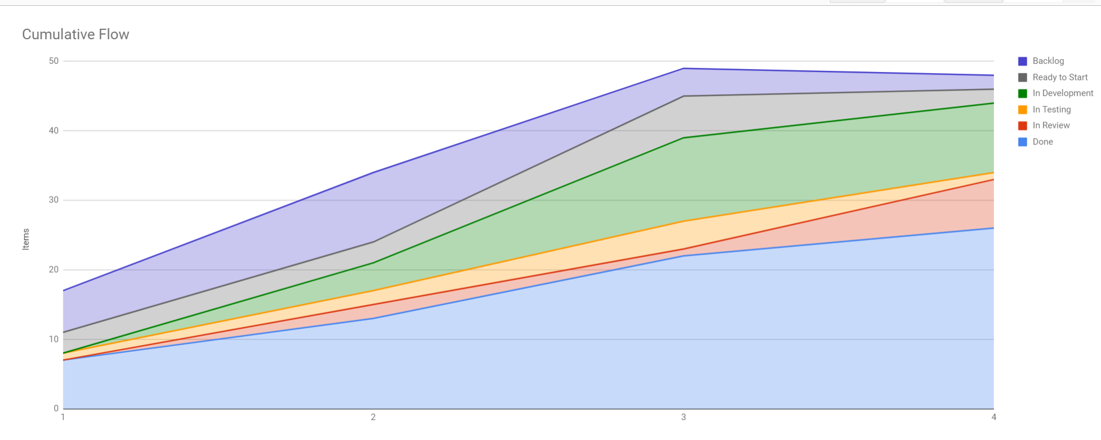
Cumulative Flow Diagram
https://docs.google.com/spreadsheets/u/1/d/1KnVS7Ho-DlToUMpmdLaP6jSARa9GZJmGStukzRc008Y/edit?usp=sharing

Slide 30
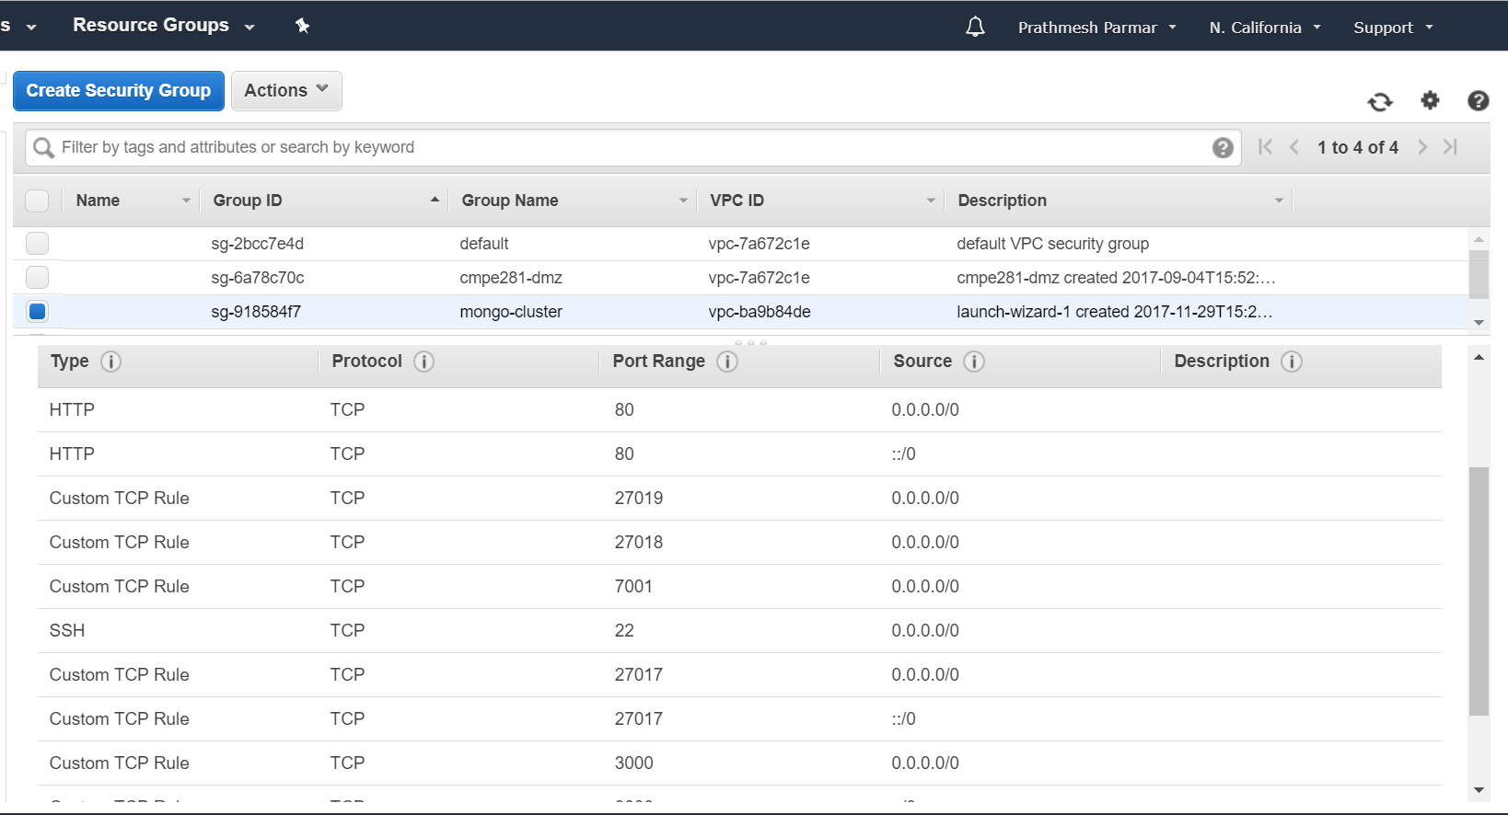
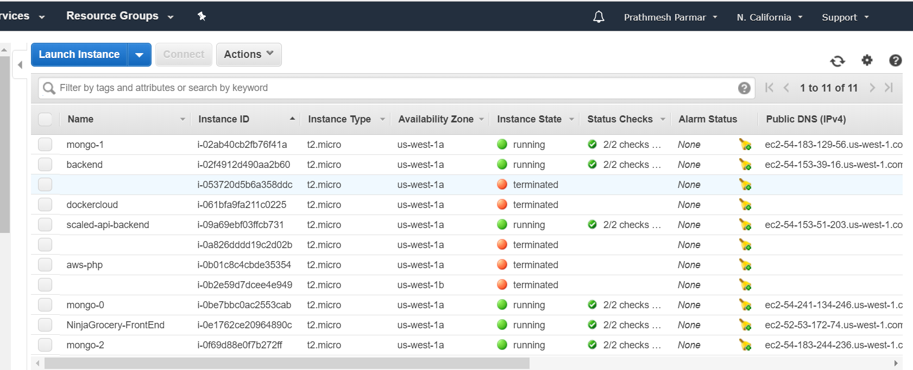
User Session – Security Group & EC2

Slide 31
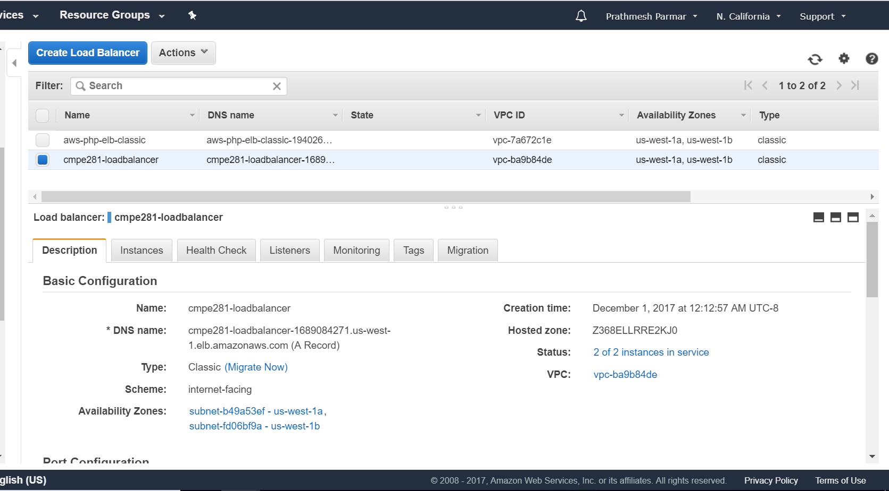
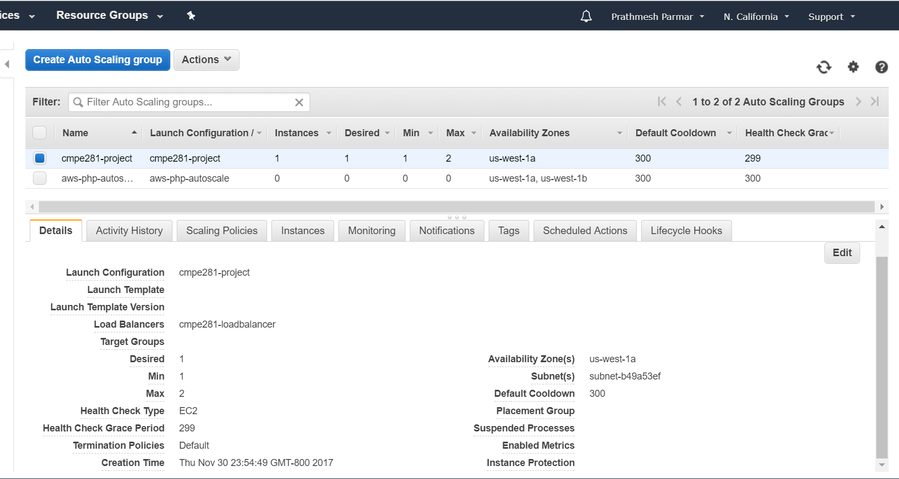
User Session-Load Balancer & Auto Scaling Group

Slide 32
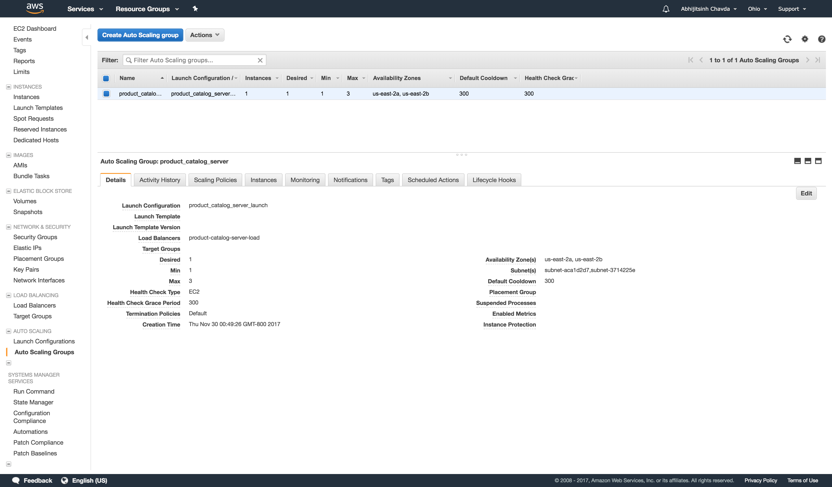
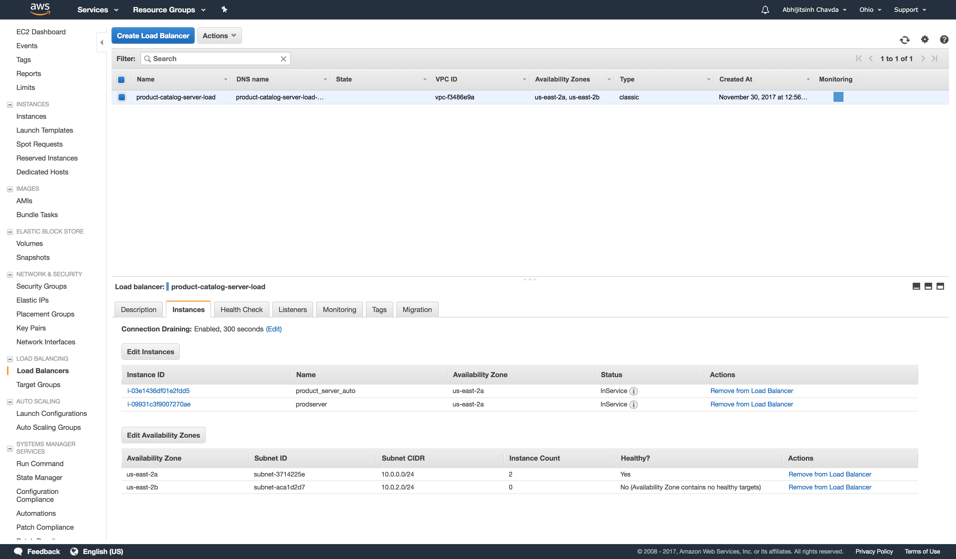
Product Catalog-Load Balancer & Auto Scaling Group

Slide 33
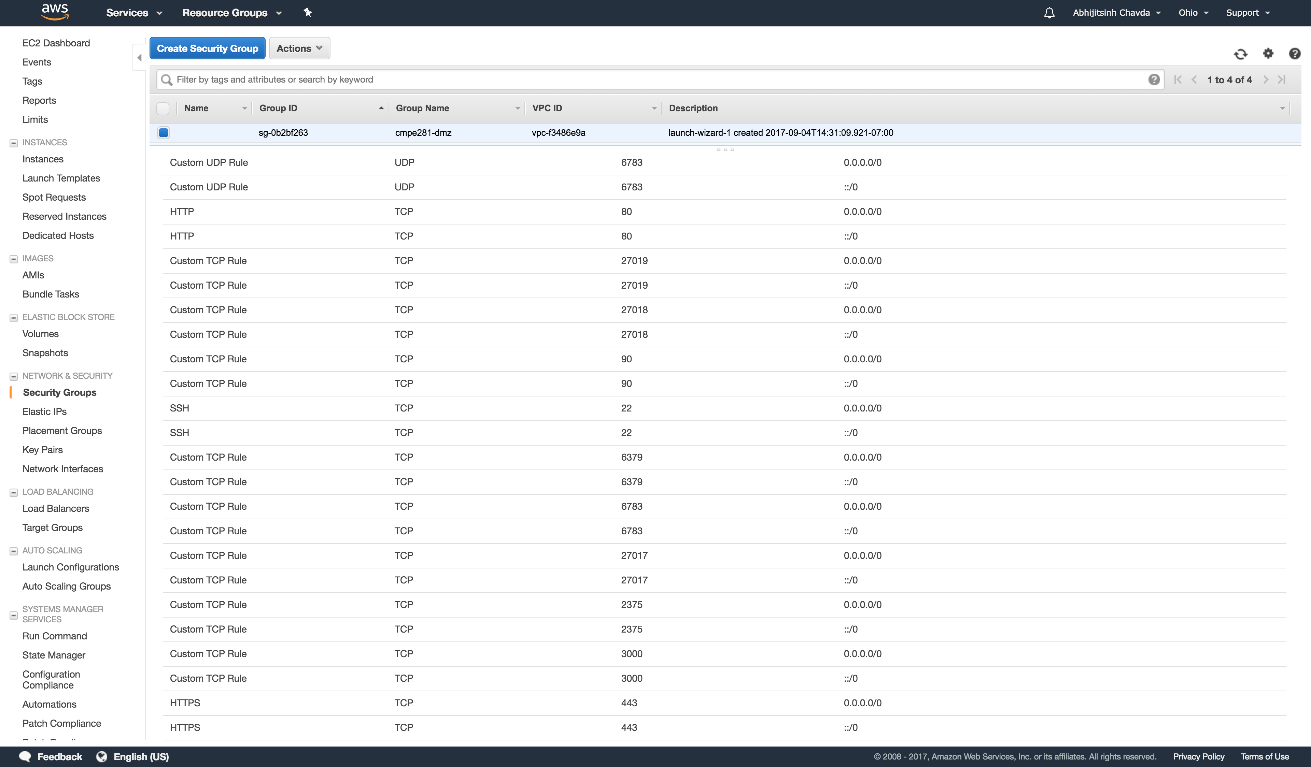
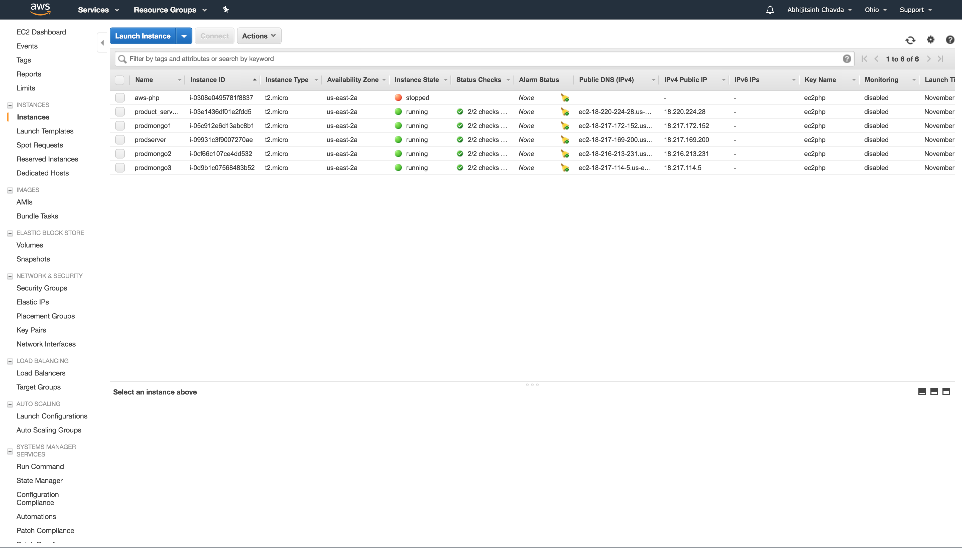
Product Catalog –EC2 & Scaling Group

Slide 34
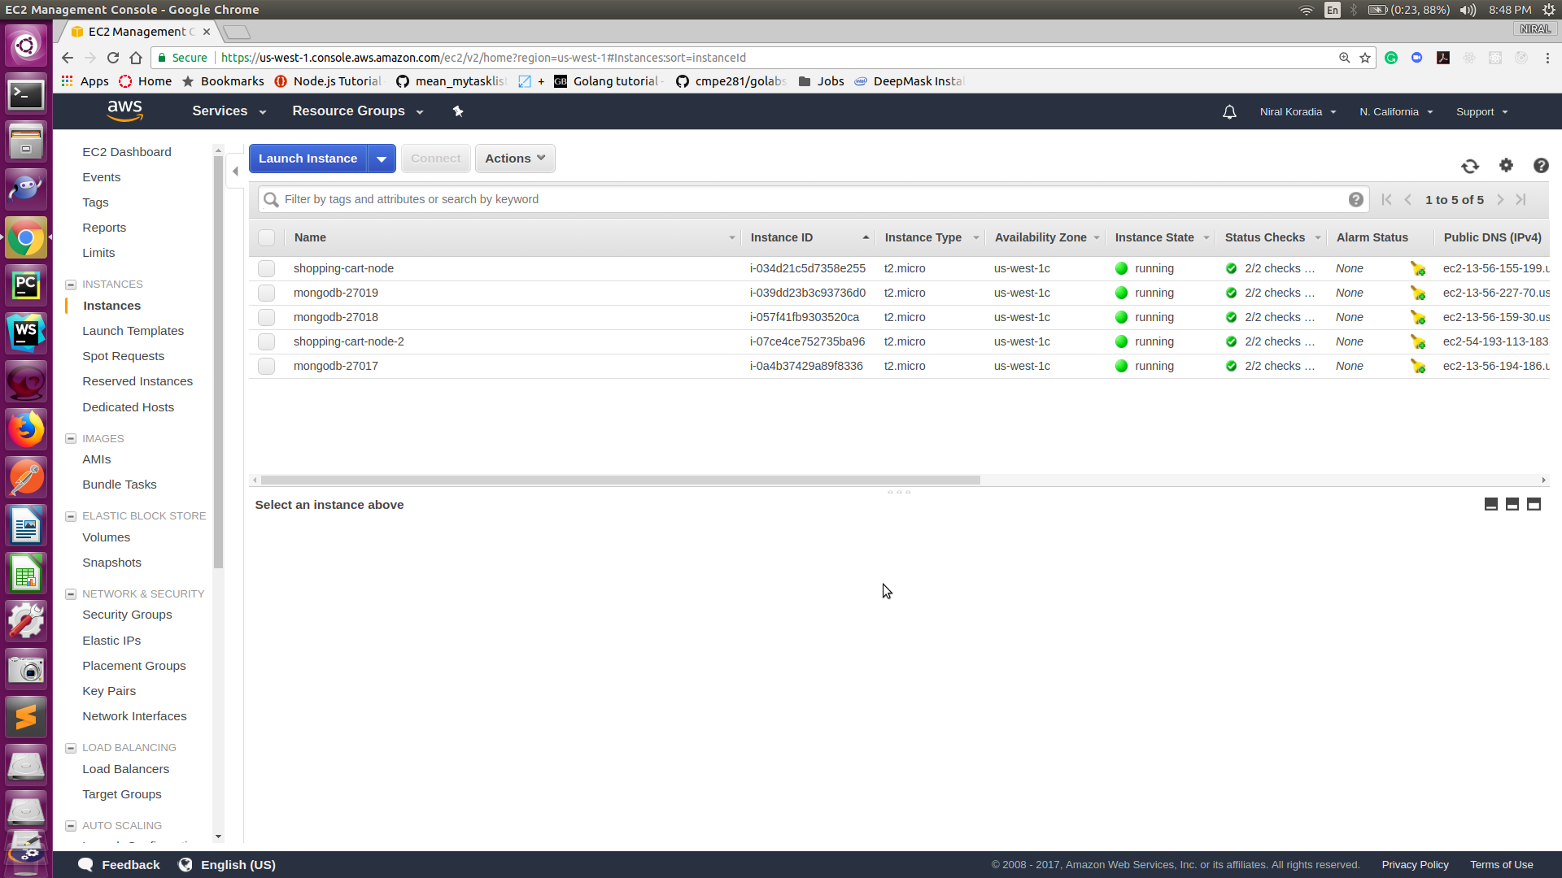
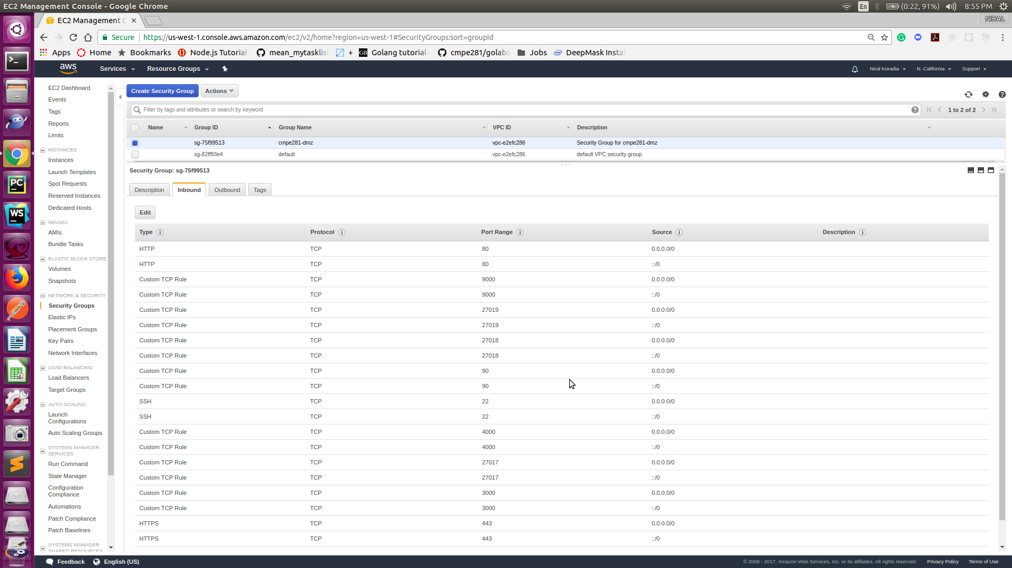
Shopping cart – Security Group & EC2

Slide 35
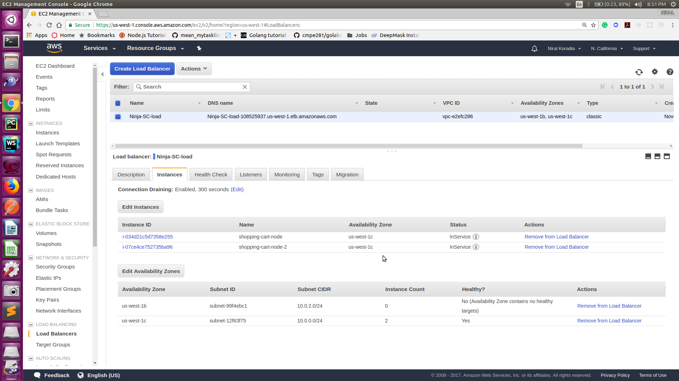
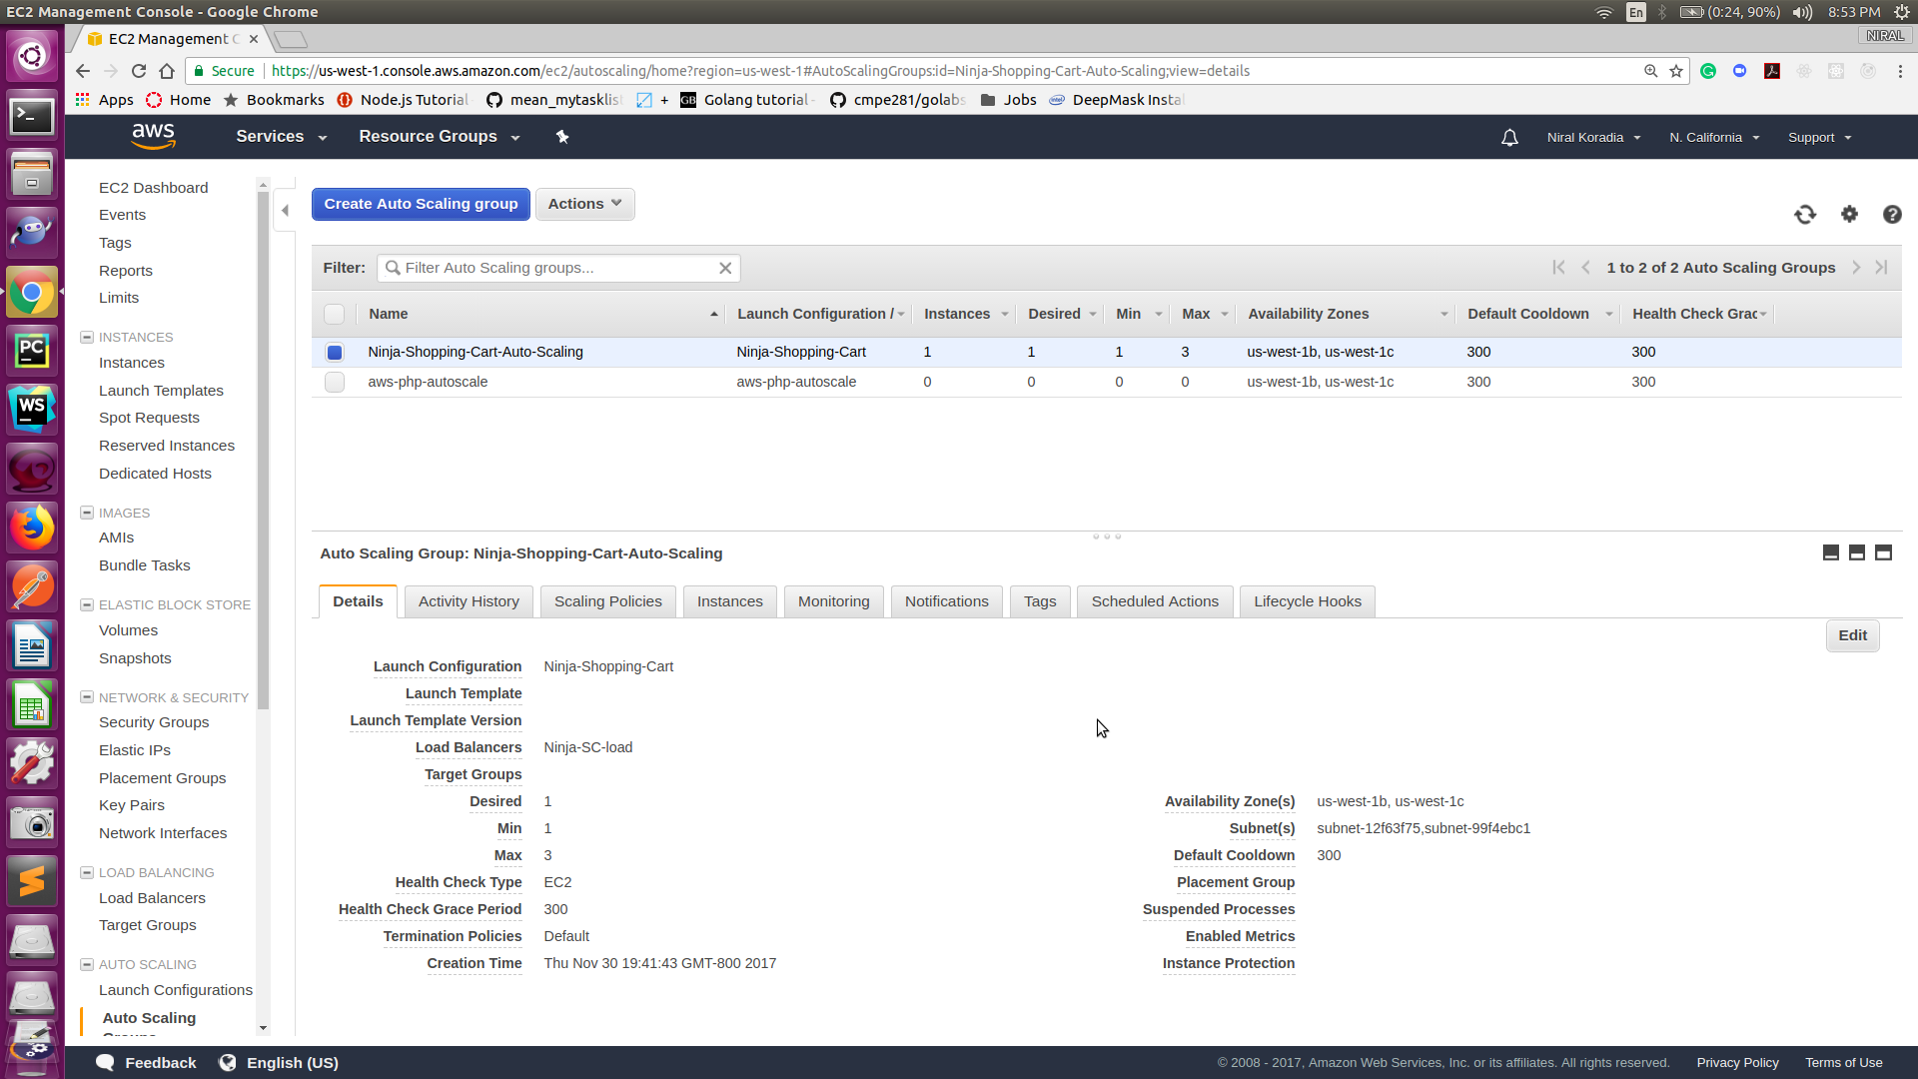
Shopping cart – Load Balancer & Auto Scaling Group

Slide 36
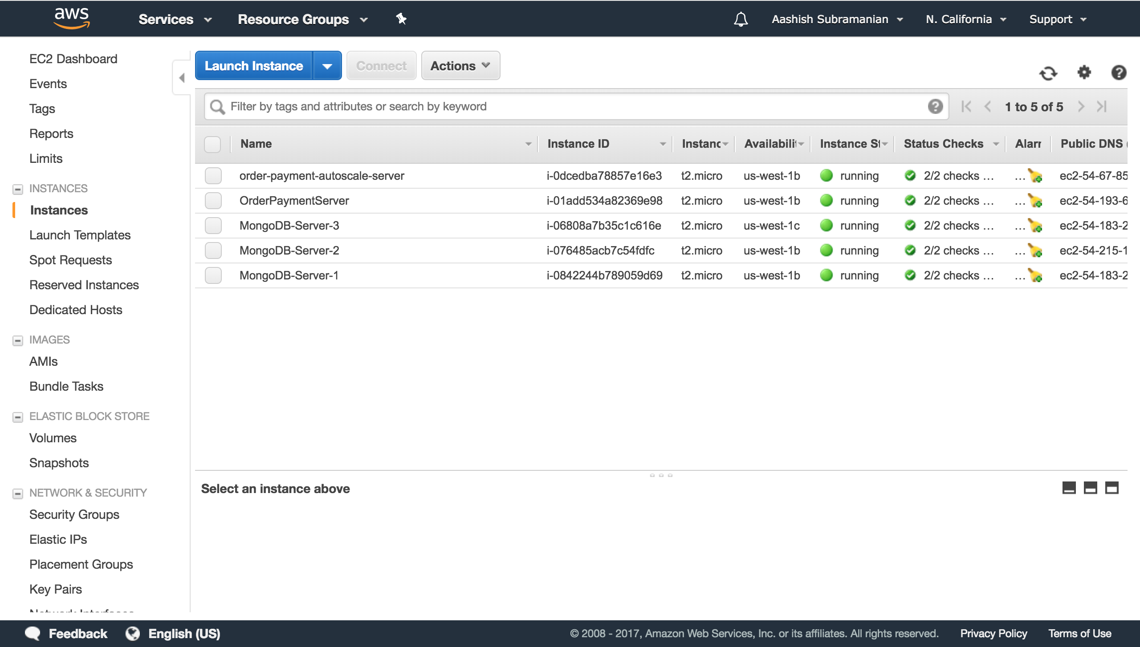
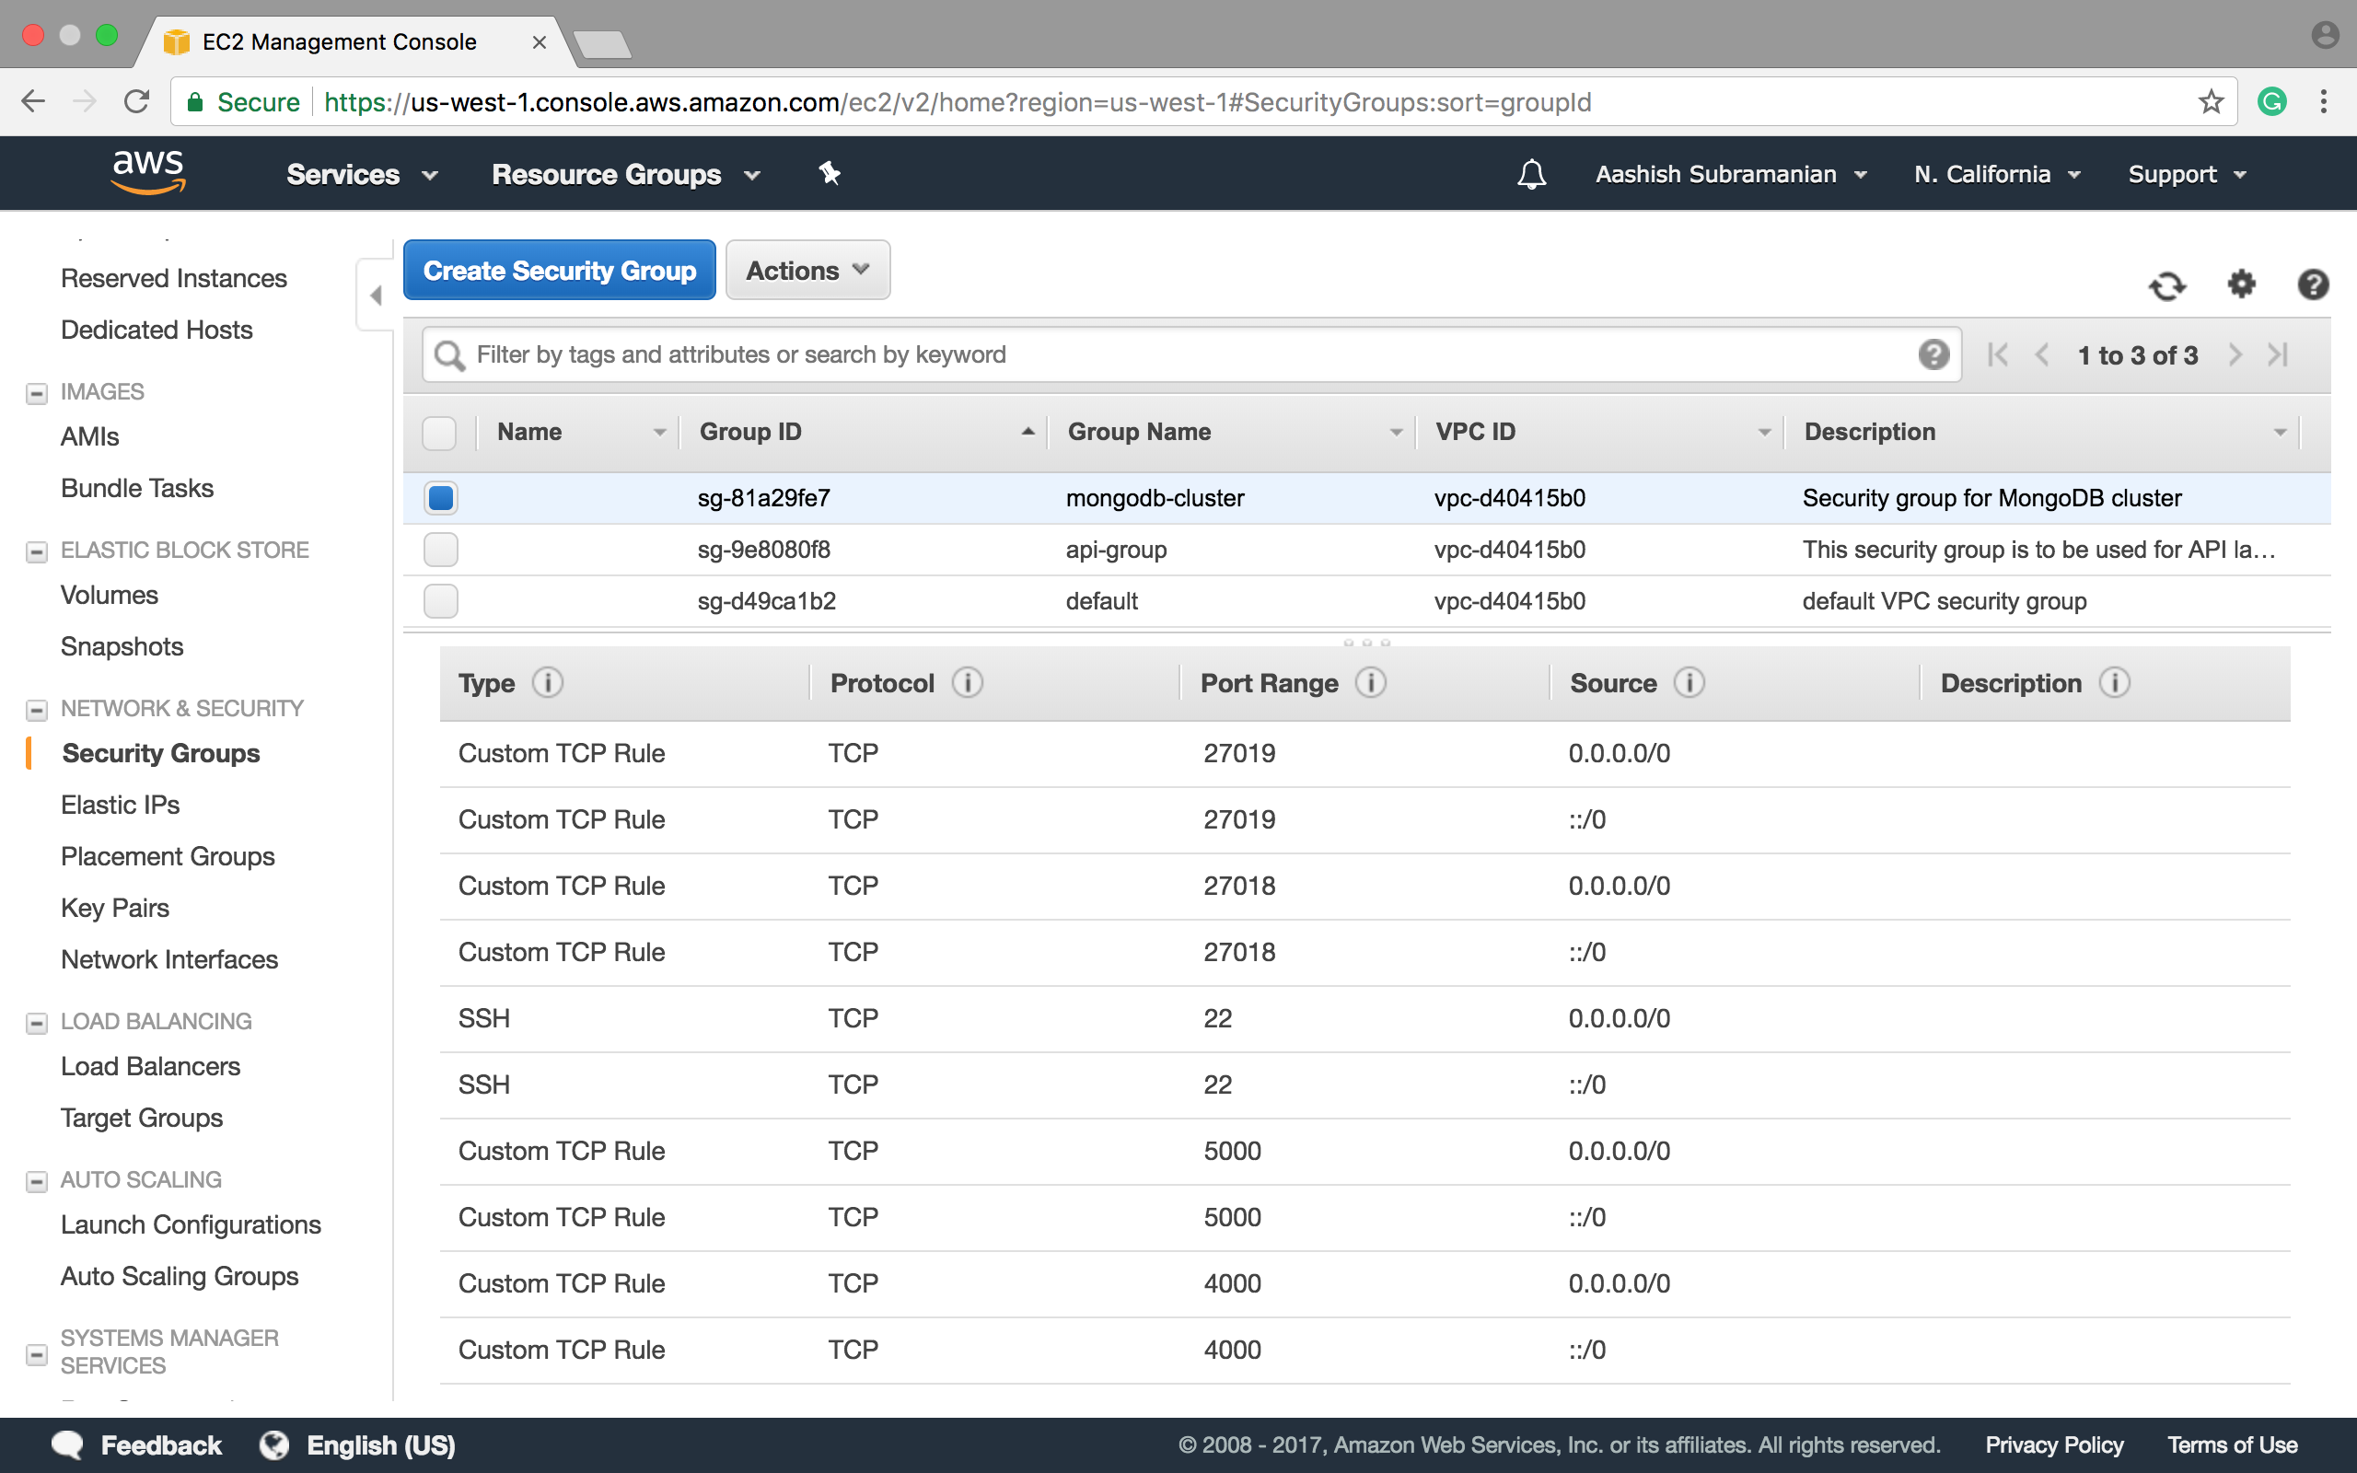
Orders/Payments– Security Group & EC2

Slide 37
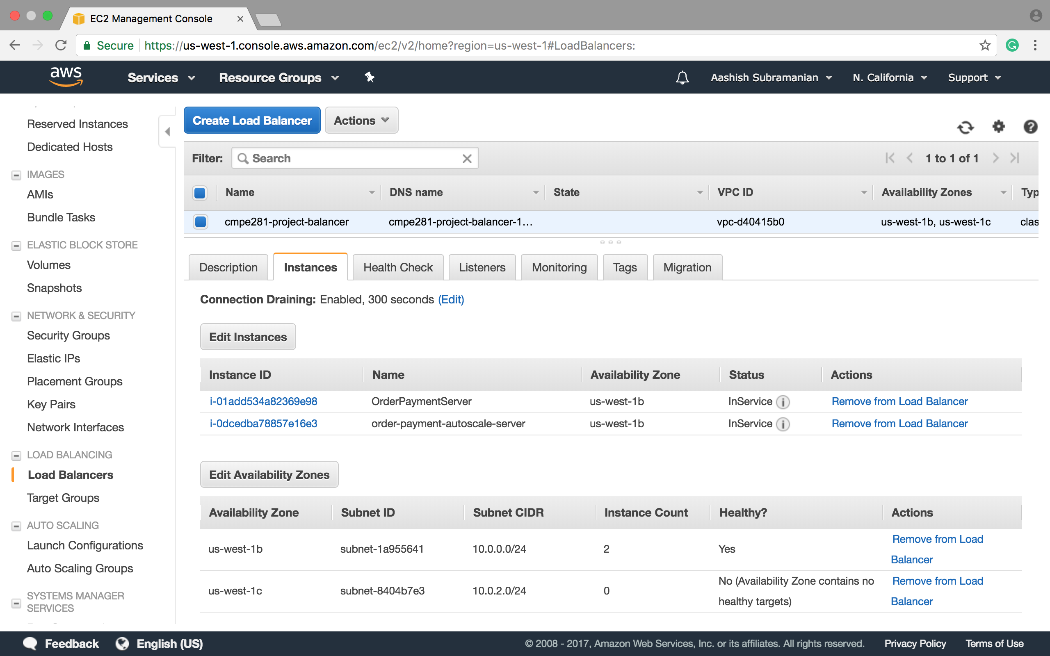
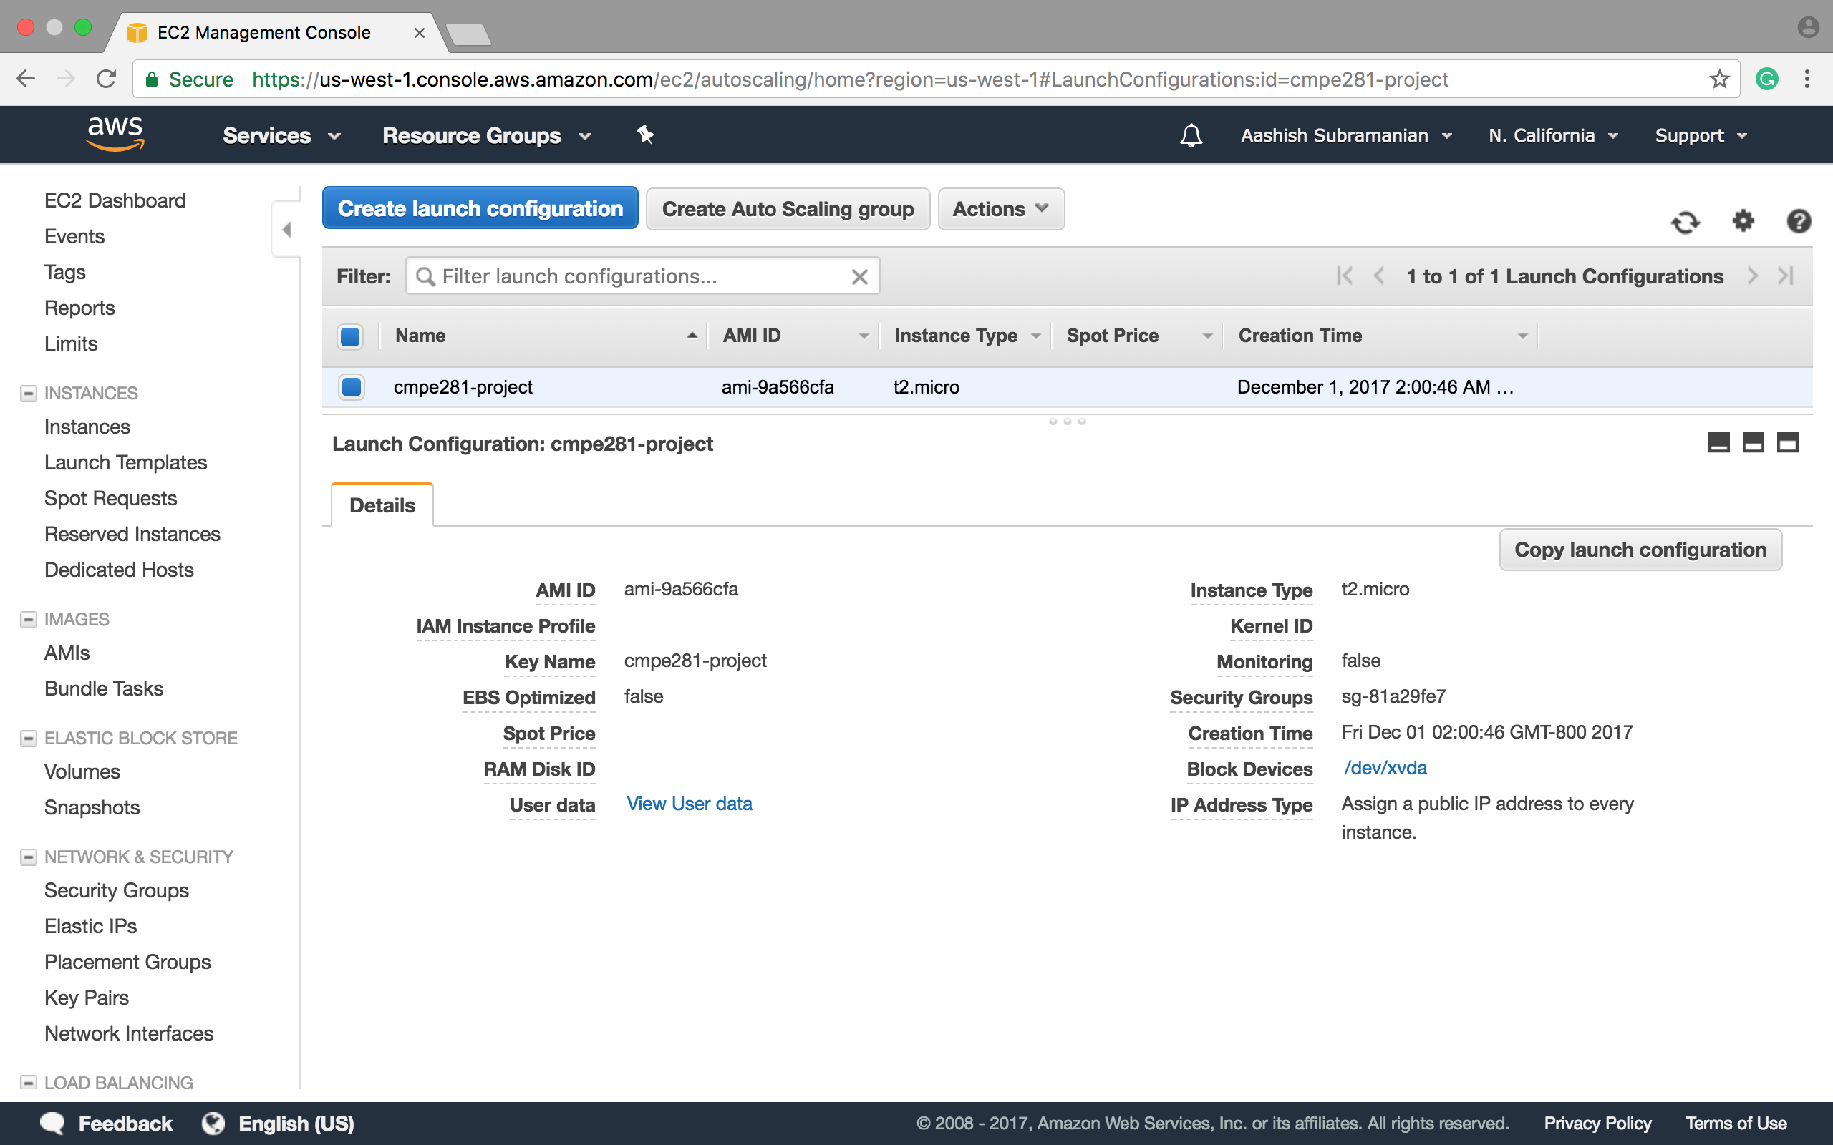
Orders/Payments-Load Balancer & Auto Scaling Group

Slide 38
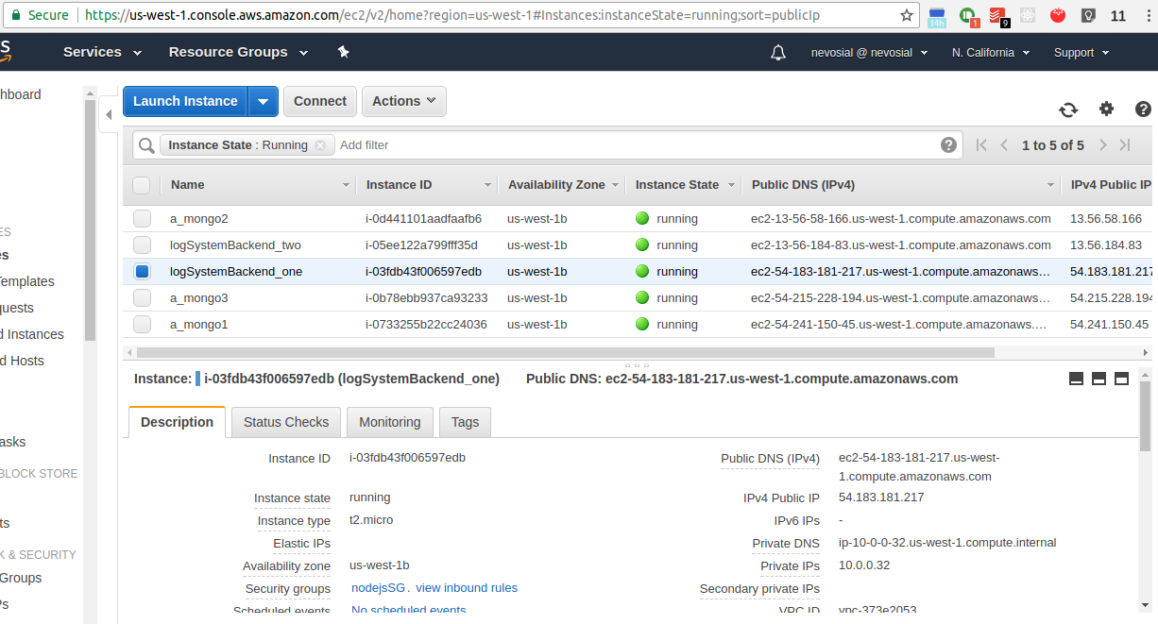
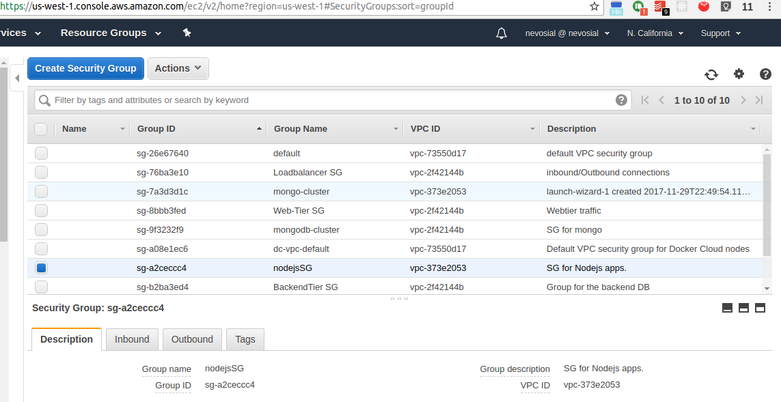
LogSystem-Security Group and EC2 instances

Slide 39
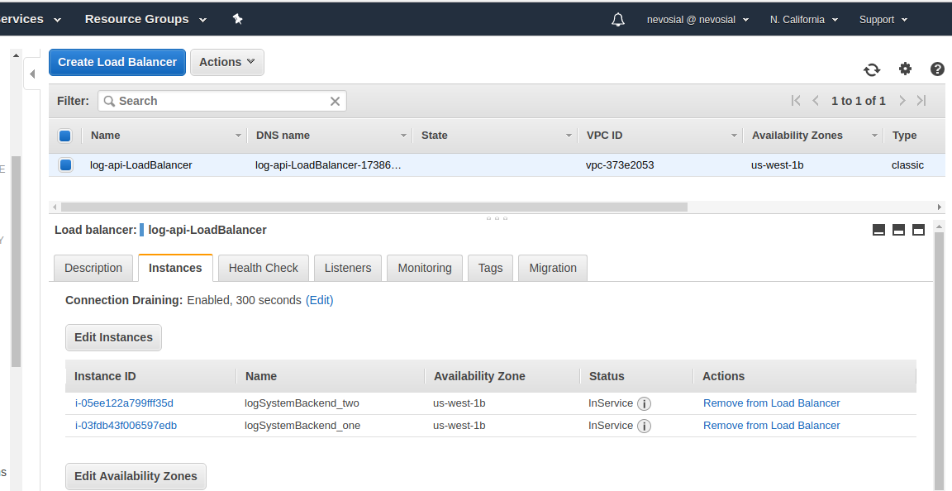
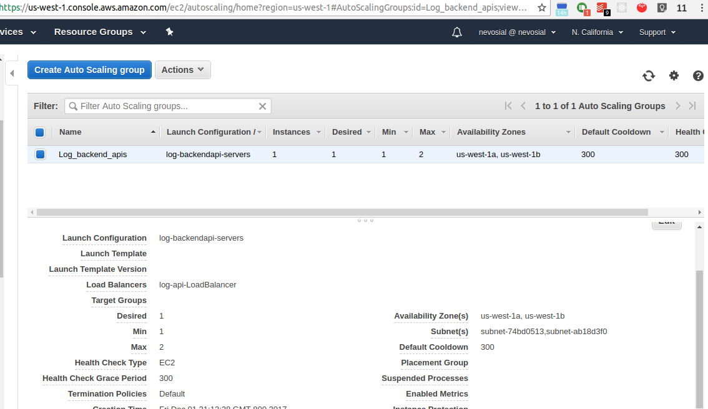
LogSystem -Load Balancer & Auto Scaling Group

Slide 40
Demo
<link>

Slide 41
Team Retrospective

Slide 42
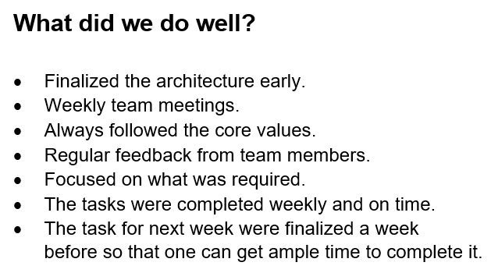
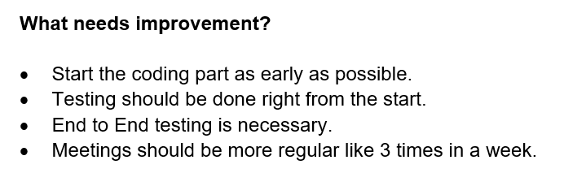
Team Retrospective

Slide 43
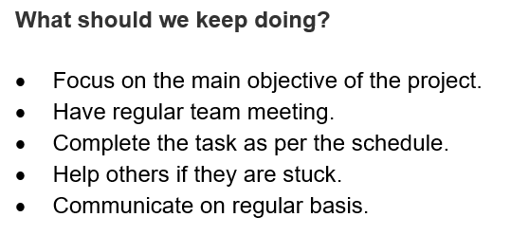
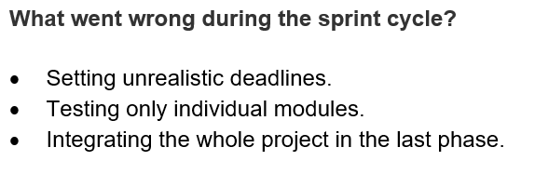
Team Retrospective

Slide 44


